Slide 1

SUPERSTORE DATASET TABLEAU DASHBOARD
Tableau Project
Presentation
By Neeti Kishor Patel

Slide 2
Agenda
Data Import and Preparation
KPI sheet
Time trends
Key insights
Dashboard integration
Final review and conclusion

Slide 3
Data Import and Preparation
Load and clean the dataset (handle missing values, data types, duplicates).
Format date columns for monthly/yearly grouping.
Create calculated fields: Total Sales, Profit, Quantity, Discount.

Slide 4
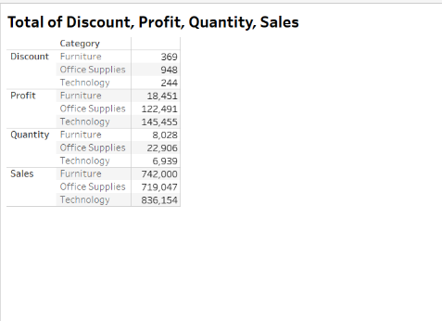
KPI sheet

Slide 5
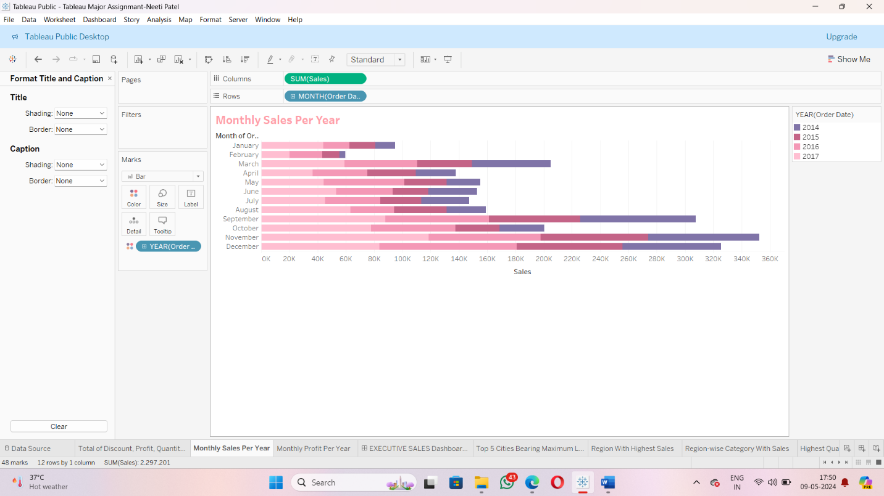
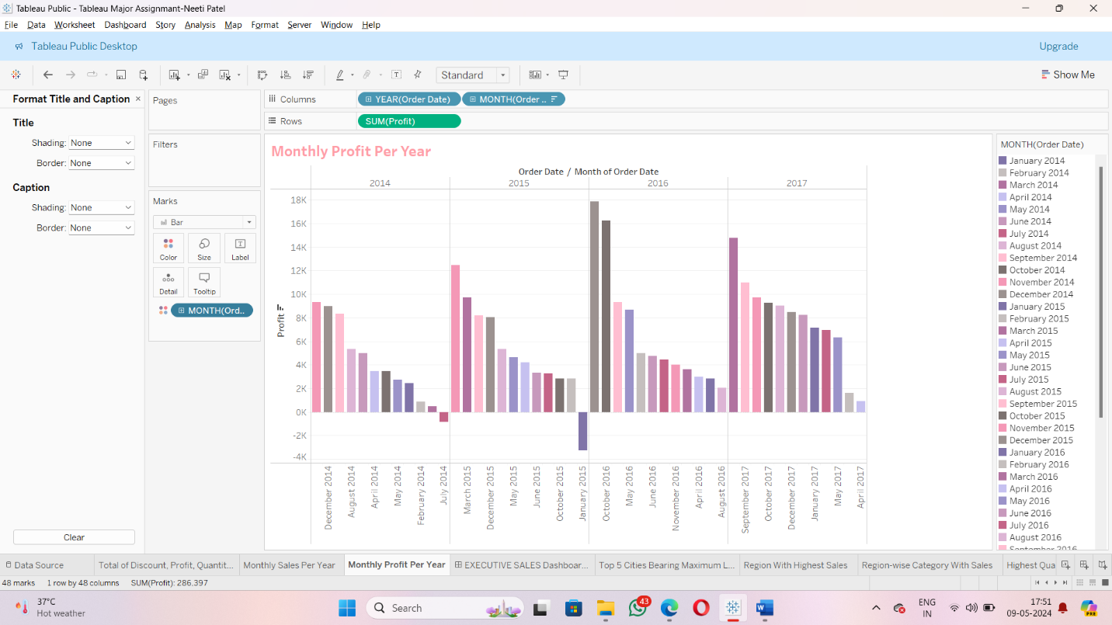
Time trends

Slide 6
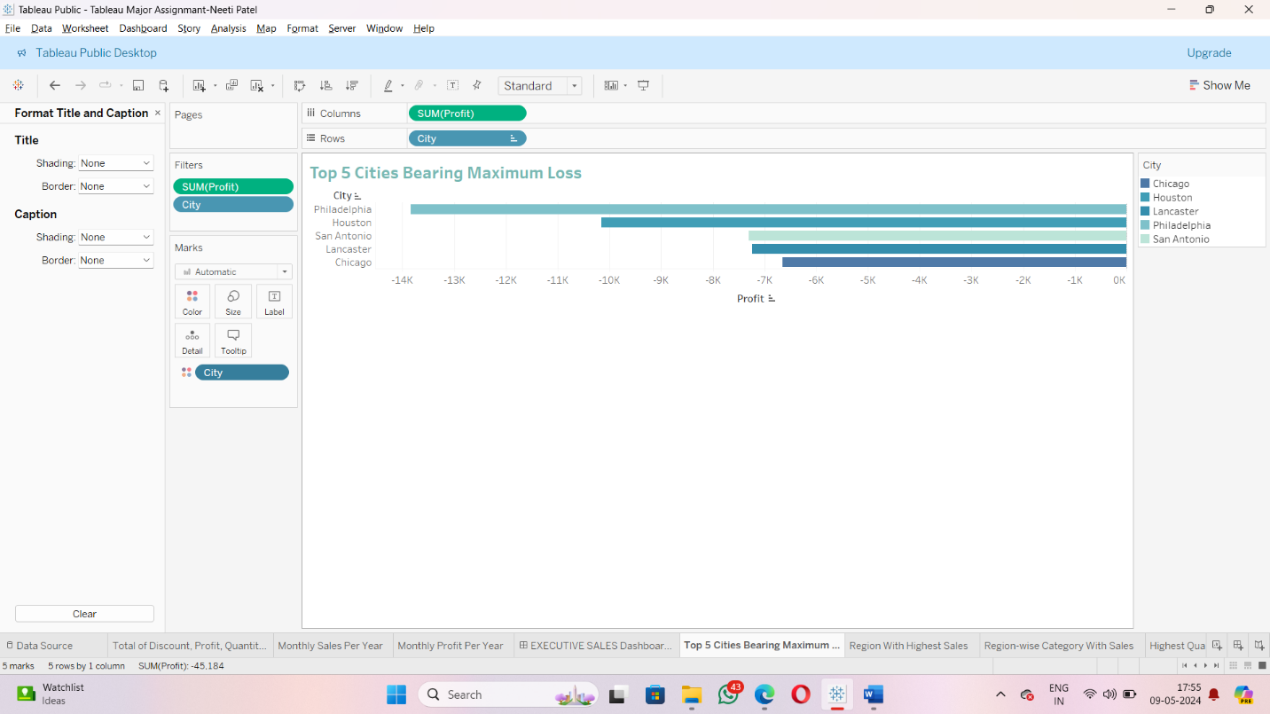
Key insights
Top 5 cities that bear a maximum loss

Slide 7
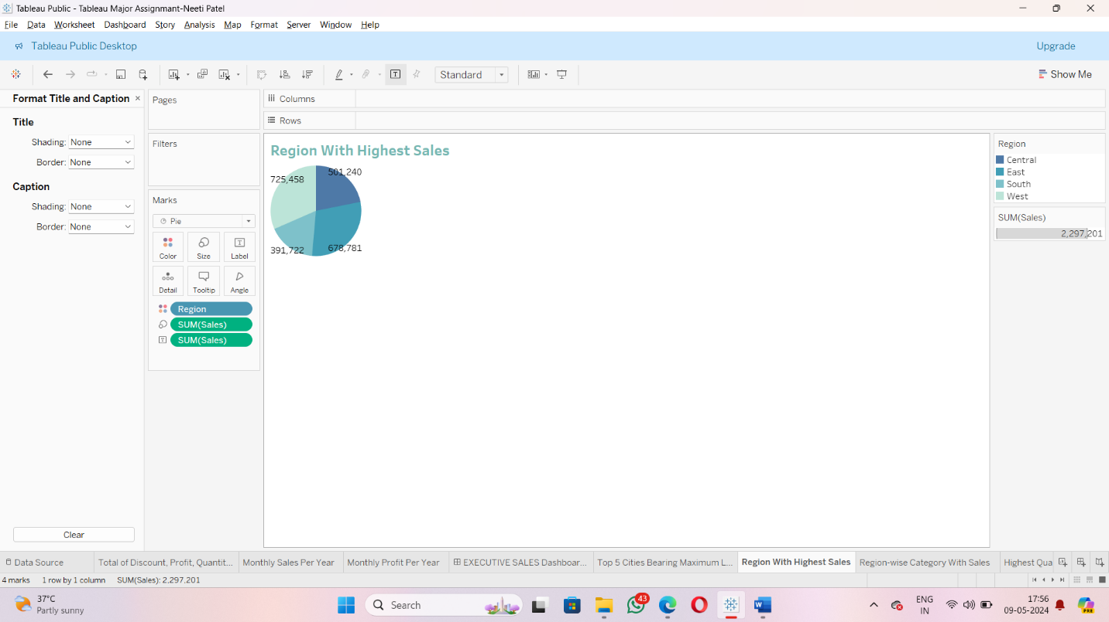
2) Which is the region with the highest sales?

Slide 8
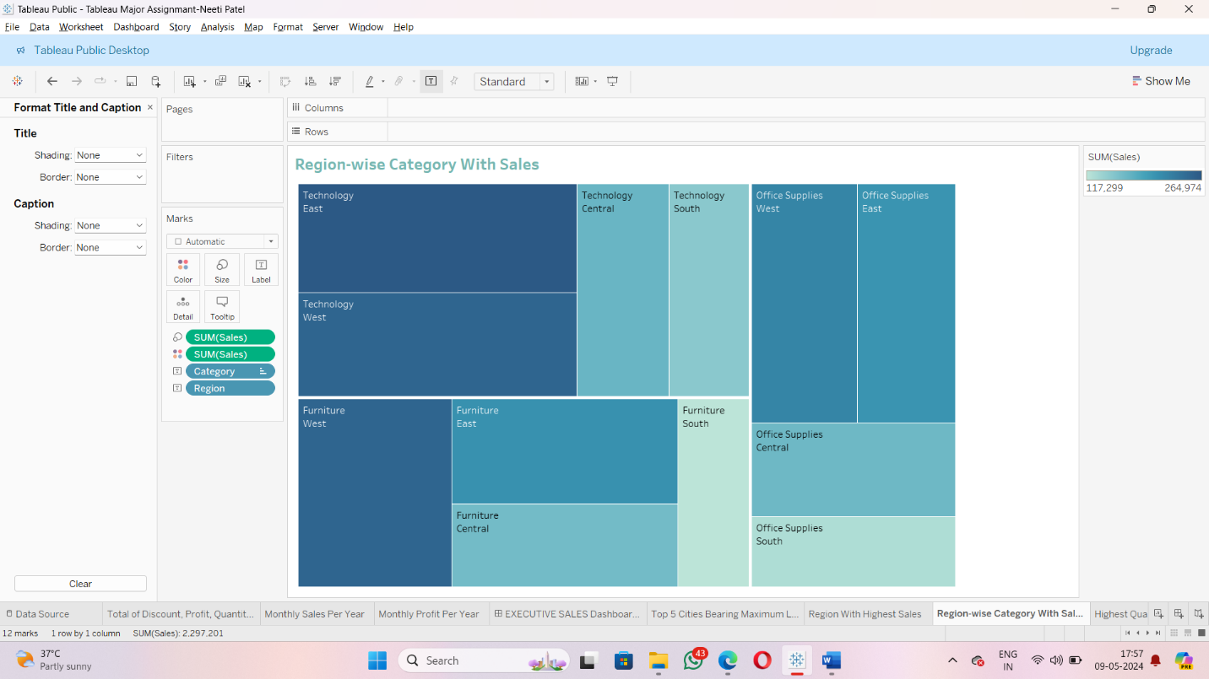
3) Name the category in the region with the highest sales

Slide 9
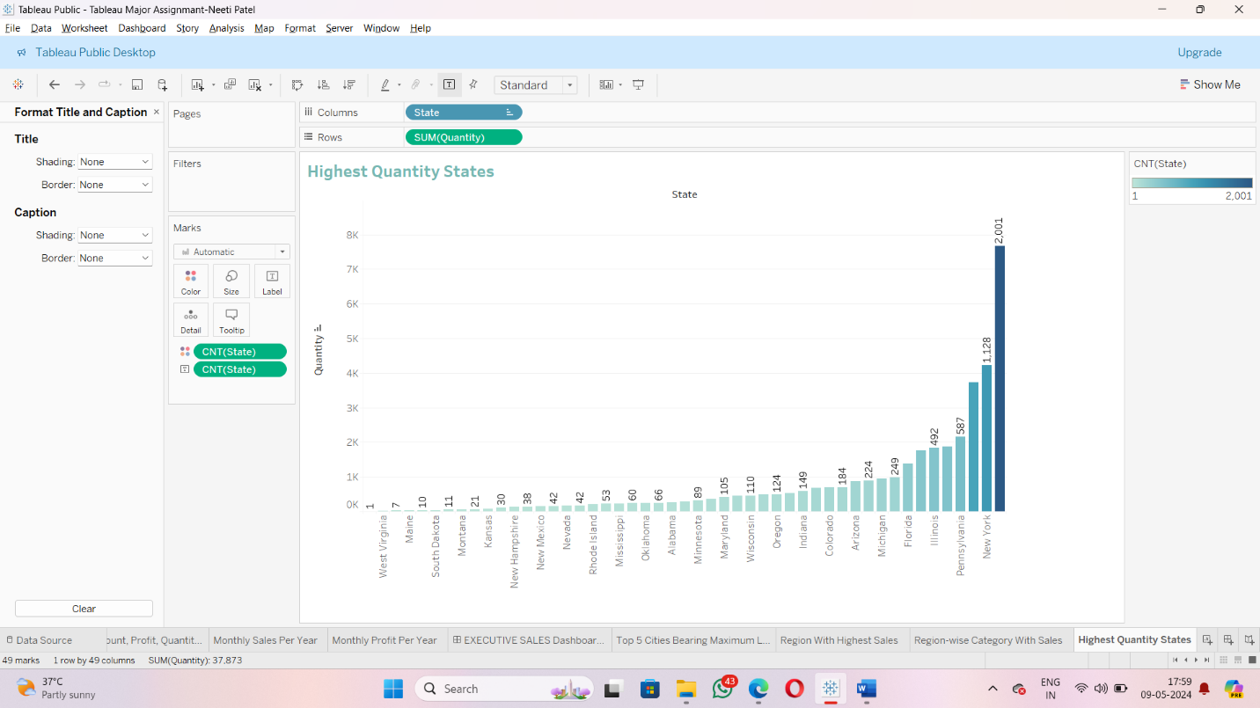
4) Which state has the highest quantity of orders?

Slide 10
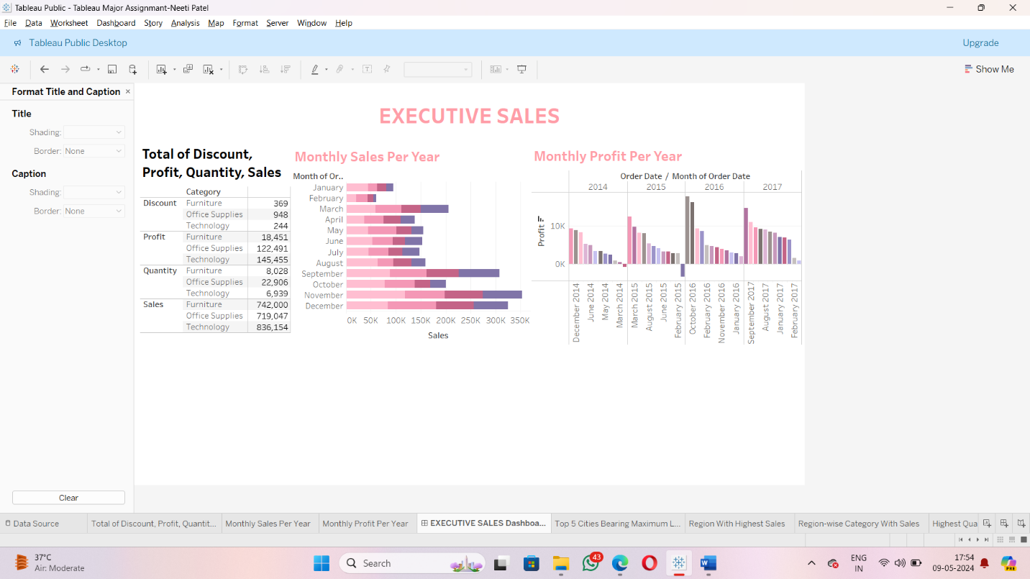
Dashboard integration

Slide 11
Final review and conclusion
The project successfully analyzed sales data to uncover valuable business insights, presented through a clear and structured dashboard. Key metrics—sales, profit, quantity, and discount—were highlighted for quick reference, while time-based trends offered visibility into performance over the years.
The analysis also identified top loss-making cities, the highest-performing region and category, and the state with the most orders. Overall, the dashboard serves as a strong decision-support tool for monitoring business health and guiding strategic actions.

Slide 12
THANK YOU!

